Slide 1
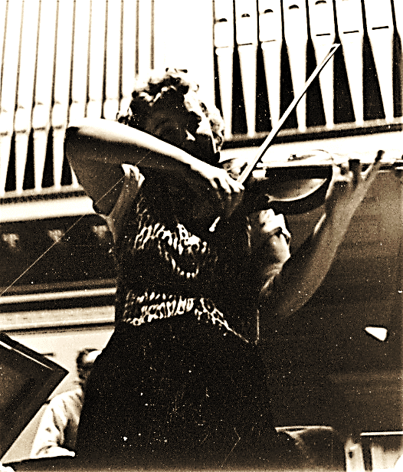

PACTING WITH THE DEVIL: INTRODUCTION
“I am a fiddler and a good fiddler plays like the Devil.”
—Ruth Posselt, American violinist
Audio: The Devil Came to Georgia

Slide 2
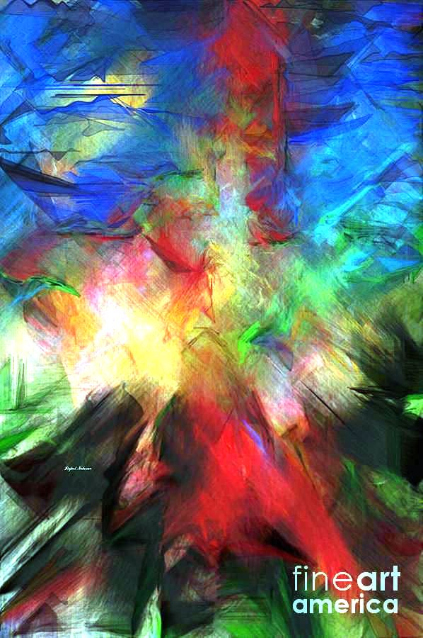
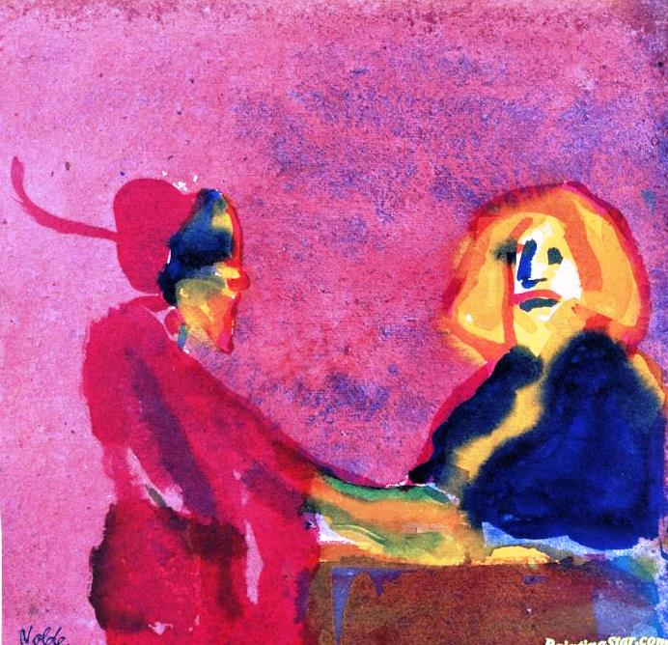
I. PACTING WITH THE DEVIL THROUGHOUT HISTORY
This course tells the story of a man, named Faust, who made a pact with the devil.
Johannes Faust was a real person; he lived in Germany in the 16th c. Legends and tales about Faust ultimately overshadowed the known facts of his life.
Faust’s story has inspired countless literary works, paintings, operas, songs, sculptures and other cultural monuments all over the world. Some of them are pictured on this and the next slide.
Faust & Mephistopheles
Salazar: The Mystic Faust
Emil Nolde: Faust & Mephisto
Opera poster: Gounod’s Faust

Slide 3
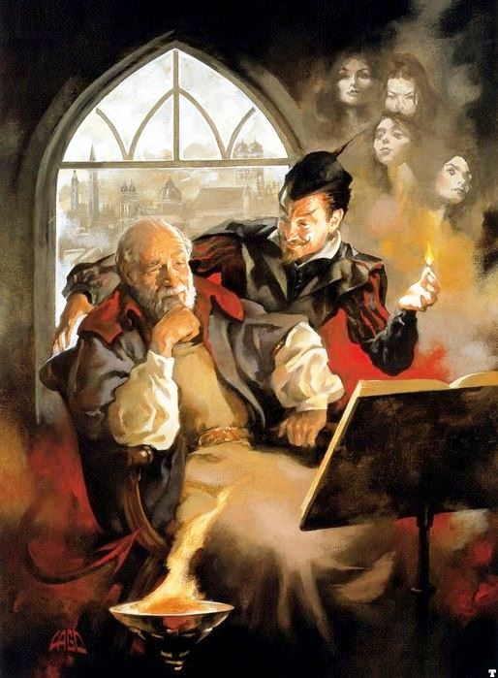
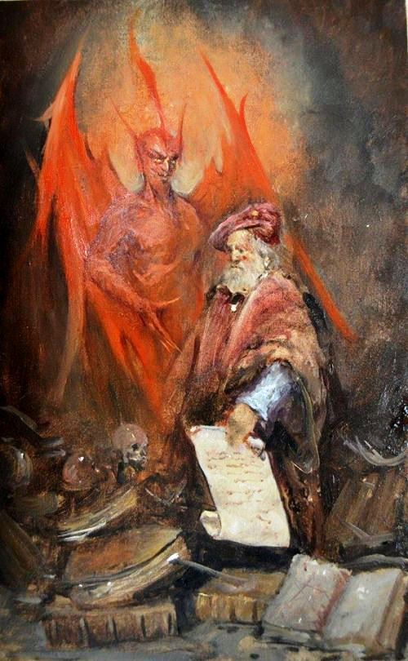
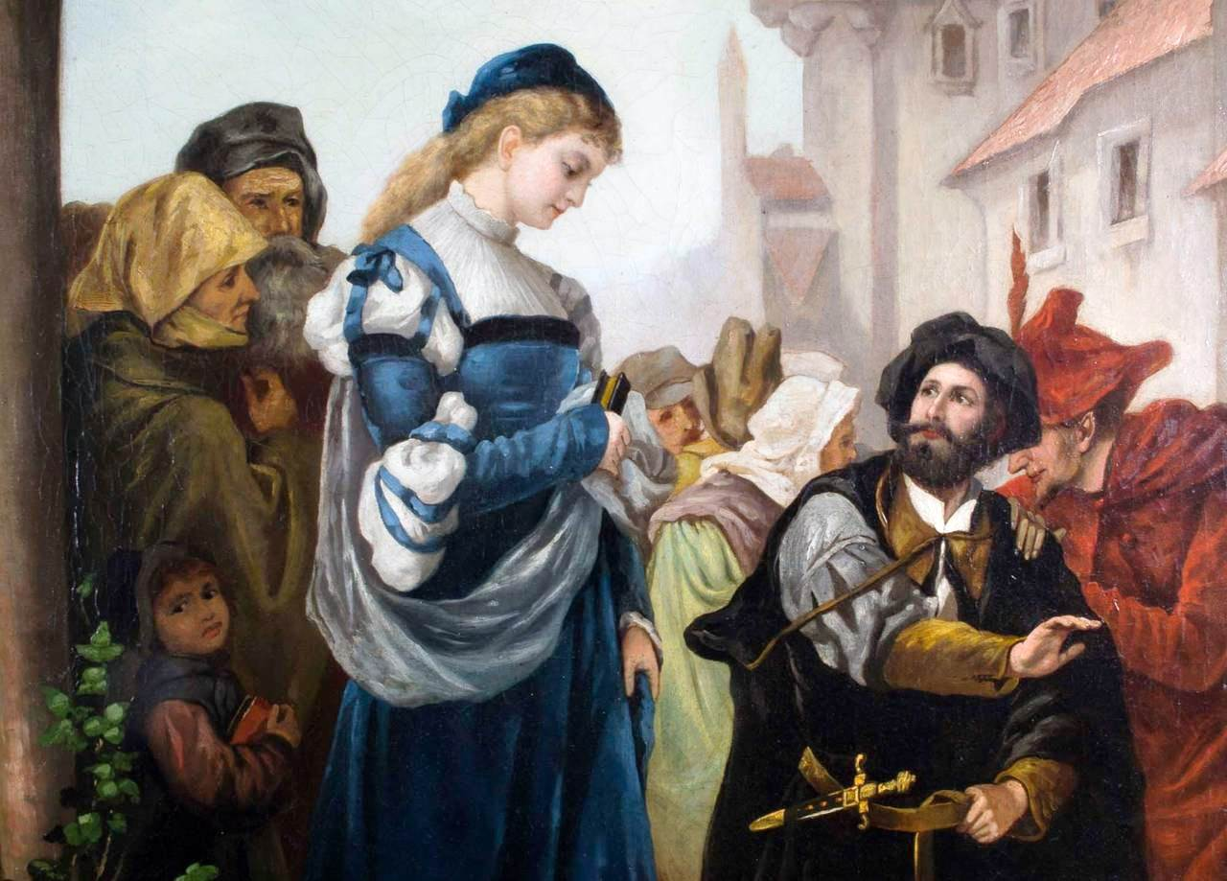
The popularity of the Faust story stems from the fact that human desires and dreams are universal. Moreover, when people want something that may be difficult or impossible to get, they sometimes resort to evil (negative) means to get it quickly and easily, even though they realize there may be consequences, or HELL TO PAY.
Mephistopheles in Faust’s study tempting him with Gretchen’s image
Statue of Faust & Mephisto
Outside of Auerbach’s cafe
Mephisto appears to Faust in his study
Scene from Gounod’s opera Faust
Werner: “Faust and Margaret”

Slide 4

II. WHO WAS/IS THE DEVIL? SHIFTING IDENTITIES
1. THE FALLEN ANGEL
2. EVIL INCARNATE
3. A METAPHYSICAL BEING
4. HEAD OF A DEMONICAL CHURCH & ARMY
5. THE EVIL ARM OF GOD
6. THE SPIRIT OF NEGATION
7. A SYMBOL & LITERARY PERSONALITY
8. A COMEDIAN OR VAUDEVILLIAN
9. THE REALITY OF EVIL IN THE WORLD

Slide 5
III. WHAT WAS THE DEVIL’S NAME? The origin of the name Mephistophiles, which first appeared in the German Faustbook, 1587.
Mephistophilis is neither a traditional Judeo- Christian, nor a folkloric name.
Its derivation remains uncertain, but the chief elements are, FROM GREEK:
me= not;
phos = light;
filos=lover.
“NOT A LOVER OF LIGHT.”

Slide 6
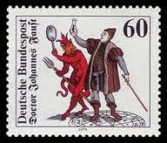
IV. IS THE DEVIL REAL?
“Wherever [God] is…there too the devil belongs, and asserts his complementary reality to that of God. A modern theologian may take the devil symbolically, but why should hell be more symbolical than heaven? The people have certainly never thought so. The crass, obscenely comic figure of the divel has always been nearer to them than the Eternal Majesty.”
(Thomas Mann, Dr. Faustus)

Slide 7
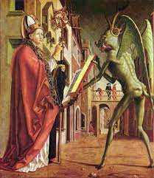
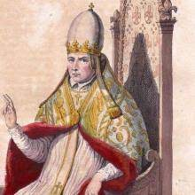
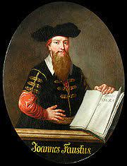
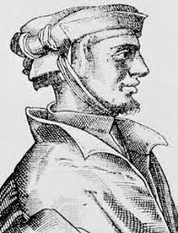
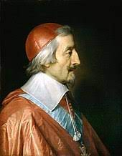
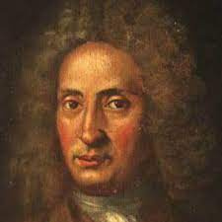
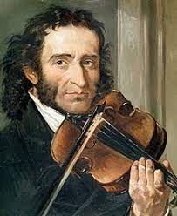
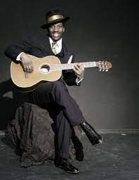
V. EIGHT REAL PEOPLE WHO PACTED WITH THE DEVIL
1) Theophilus
2) Pope Sylvester
3) Johann Faust
4) Cornelius Agrippa
5) Urbain Grandier
6) Giuseppe Tartini
7) Nicolo Paganini
8) Robert Johnson

Slide 8

1. THEOPHILUS OF ADANA (died 538 ) was a sixth century clergyman.
Theophilus contacted Satan in order to get the position of bishop in his church.
Satan demanded he renounce Christ and the Virgin Mary in a contract signed with his own blood. Theophilus complied and the Devil gave him the position of bishop.
Years later, Theophilus repented, and prayed to the Virgin for forgiveness. Mary interceded with God, and Theophilus was granted Absolution. But Satan fought for 3 days against Mary before giving back the damning contract .
Theophilus confessed to all he had done; the bishop burned the document and Theophilus expired out of joy.
St. Wolfgang & the Devil, 1471-75 by Michael Pacher

Slide 9
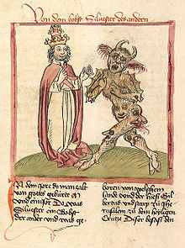
2. GERBERT D’AURILLAC (LATER, POPE SYLVESTER II) was a French monk and one of the most learned men of his time. Gerbert invented the hydraulic organ, pendulum clock, and introduced Arabic numerals to Western Europe.
He was the first French Pope (999-1003). Due to his effort to end simony (profit-making from sacred things) and other forms of corruption within the Church, and his connection with science and great learning, Gerbert was widely rumored to be a sorcerer in league with the Devil.
Gerbert d’Aurillac (Pope Sylvester II)
c. 945-1003

Slide 10
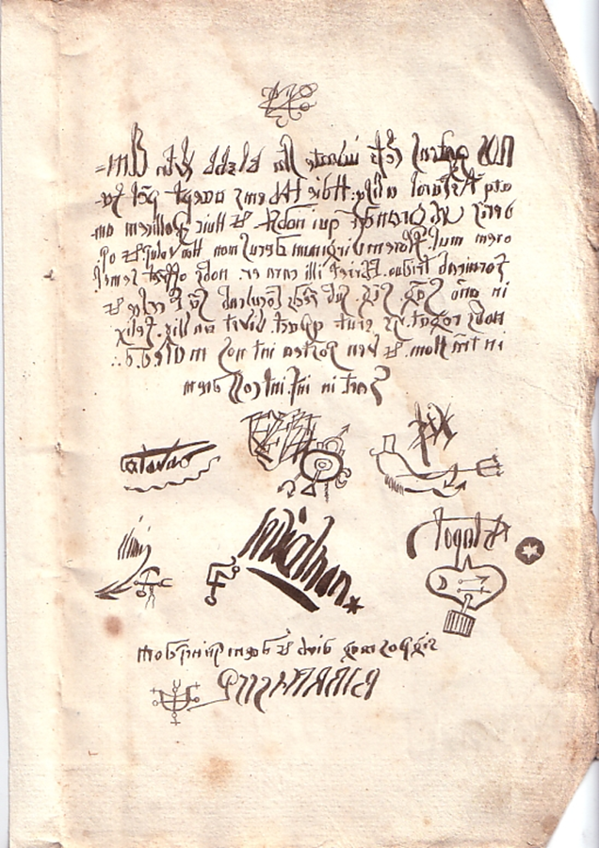
Grandier’s Pact was written backwards in Latin:
“We, the influential Lucifer, the young Satan, Beelzebub, Leviathan, Elimi and Astaroth, together with others, have today accepted the covenant pact of Urbain Grandier, who is ours. And him do we promise the love of women, the flower of virgins, the respect of monarchs, honors, lusts and powers. He will go whoring 3 days long, the carousal will be dear to him. He offers us once in the year a seal of blood, under his feet he will trample the holy things of the church and he will ask us many questions; with this pact he will live 20 years happy on the earth of men, and will later join us to sin against God. Bound in hell, in the council of demons.”

Slide 11

3A. JOHANN GEORG FAUST [“FIST”]
Faust was an itinerant alchemist, astrologer, and magician of the German Renaissance (Reformation) whose legend overtook the ascertainable facts of his actual life.
Stories about Faust were first published in the 1580’s, in German. The great English Renaissance playwright, Christopher Marlowe read them in English translation, and transformed them into the tragedy, Dr.Faustus (1604). The rest is our course…
The viral popularity of the Faust story was fueled by the Protestant Reformation and the witch craze of the 16th and 17th centuries.
17th c Portrait of Johannes Faustus
by an unknown German artist

Slide 12
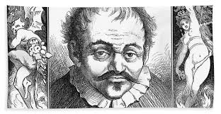
3B. JOHANN GEORG FAUST (C. 1480-C. 1540)
ENGRAVING BY JEROME DAVID FROM A SKETCH BY REMBRANDT

Slide 13
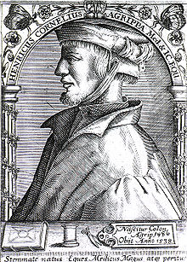
4.CORNELIUS AGRIPPA
A German magician, occultist, theologian, astrologer, and alchemist, Agrippa wrote the foundational book of early modern occult thought, De occulta philosophia libri tres.
Traveling through Germany, France and Italy, Agrippa worked as a theologian, physician, legal expert and soldier. He often defended women accused of witchcraft.
Agrippa was rumored to have summoned demons, most famously a black dog, his familiar, which he conjured and released on his deathbed.
Most heretics met a far worse fate than Agrippa’s. During the witch craze, pacting with the Devil was punishable by death.
Cornelius Agrippa (1486-1535)

Slide 14
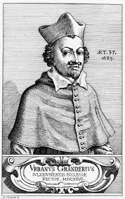
5. FATHER URBAIN GRANDIER
A French Catholic priest, Grandier was burned at the stake after being convicted of witchcraft. Judges at Grandier’s trial introduced documents purportedly signed by Grandier and several demons as evidence that he had made a pact with the devil.
It is unknown if Grandier wrote or signed the pact under torture, or if it was completely forged.
Modern scholars have concluded that Grandier was the victim of a politically motivated persecution led by Cardinal Richelieu, the chief minister of France, after Grandier had published scathing attacks against Richelieu.
Father Urbain Grandier
(c. 1590-1634)

Slide 15
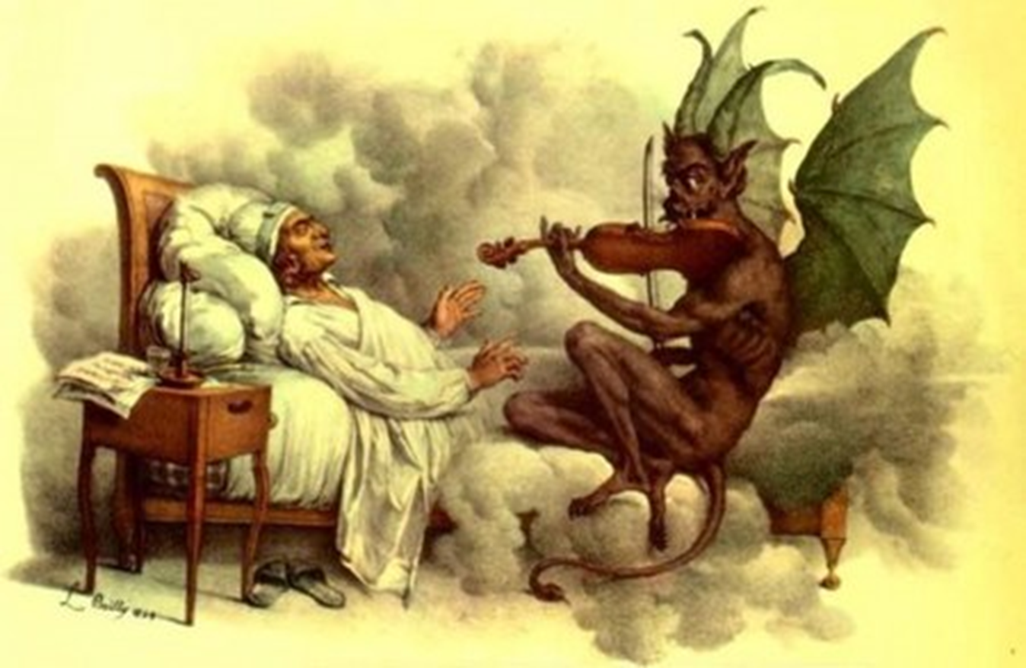
6. GIUSEPPE TARTINI
1692-1770.
An Italian composer and violinist who wrote over 400 works for the violin, Tartini once told a French astronomer that the inspiration of his most famous piece, nicknamed the Devil’s Trill Sonata, was played for him in a dream by the Devil.
“One night, in the year 1713 I dreamed I had made a pact with the devil for my soul. Everything went as I wished: my new servant anticipated my every desire. Among other things, I gave him my violin to see if he could play. How great was my astonishment on hearing a sonata so wonderful and so beautiful, played with such great art and intelligence, as I had never even conceived in my boldest flights of fantasy. I felt enraptured, transported, enchanted: my breath failed me, and - I awoke. I immediately grasped my violin in order to retain, in part at least, the impression of my dream. In vain! The music which I at this time composed is indeed the best that I ever wrote, and I still call it the "Devil's Trill", but the difference between it and that which so moved me is so great that I would have destroyed my instrument and have said farewell to music forever if it had been possible for me to live without the enjoyment it affords me.“

Slide 16
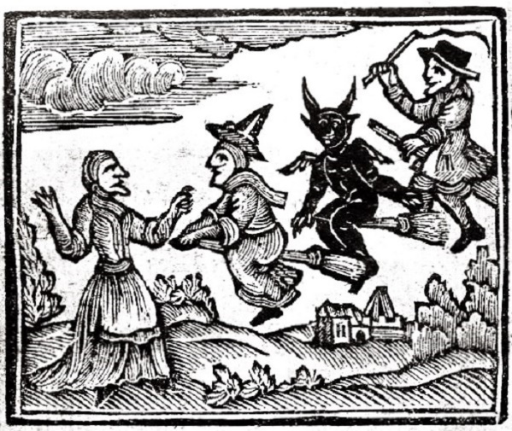
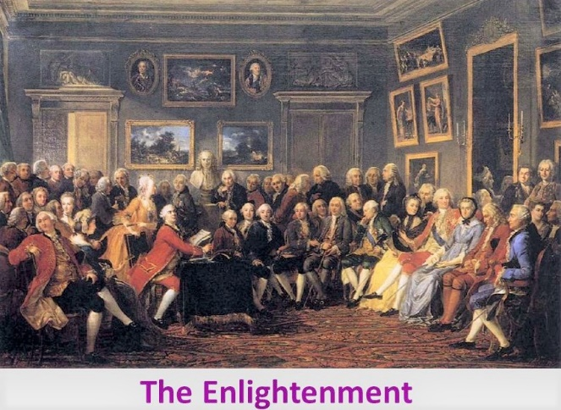
VI. WHYTHE WANING OF THE WITCH CRAZE AND THE COMING OF THE ENLIGHTENMENT WAS A TURNING POINT IN DEVIL LORE
1. Skepticism about the material reality of the Devil increased.
2. Pacts with the Devil became more symbolic
a. For example, prodigious talent on the violin, a fiendishly difficult instrument to play well, symbolized the demonic.
b. In the 18th c, the violin itself became the devil’s instrument.
(Instrumental music, “songs without words,” had long been condemned by the church.)

Slide 17
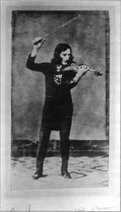
7. NICOLO PAGANINI
An Italian composer and violinist, Paganini was called “The Devil’s Son” and “Witch’s Brat” because of his demonic violin virtuosity.
Audiences thought he had made a pact with the devil to be able to perform his supernatural displays of technique.
Paganini’s appearance (the result of several serious illnesses) only enhanced his demonic aspect.
Paganini ‘s most difficult work for violin, the “24 Caprices,” was his claim to fame and became the gold standard for proof of violin virtuosity still in force today.
Here is Caprice No. 13, nicknamed the “Devil’s Laughter”, played by Jascha Heifetz, widely considered a direct virtuosic heir of Paganini.
Nicolo Paganini 1782-1840

Slide 18
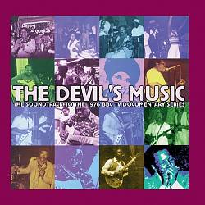
8. THE STYLE OF JAZZ KNOWN AS THE BLUES. Late 19th/early 20th century America
FROM ITS INCEPTION, JAZZ WAS CALLED

Slide 19
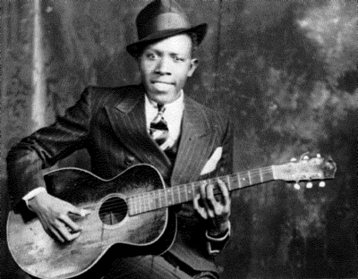
ROBERT JOHNSON was
a legendary American Blues musician, who was said to have made a pact with the devil.
Desiring to be great at guitar, Johnson was rumored to have met the devil at a crossroads (traditionally, the locus for conjuring the devil). There, the devil tuned his guitar and gave him mastery over the instrument.
Johnson encouraged the rumors by hinting that he had made a deal with the Prince of Darkness.
Now we hear Robert Johnson singing “The Crossroad Blues.”
8. ROBERT JOHNSON (1911-1938)
Notes:
Robert Johnson playing Crossroads

Slide 20
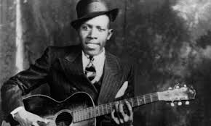

Robert Johnson (1911-1938)
Crossroad Blues
I went down to the crossroad fell down on my knees I went down to the crossroad fell down on my knees Asked the lord above "Have mercy now save poor Bob if you please" Yeeooo, standin at the crossroad I tried to flag a ride Standin at the crossroad
I tried to flag a ride Didn't nobody seem to know me babe everybody pass me by Standin at the crossroad babe risin sun goin down Standin at the crossroad babe eee eee eee, risin sun goin down

Slide 21
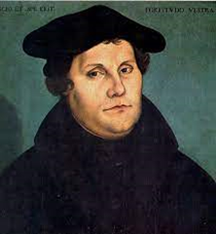
Va. AND ONE WHO WAS TEMPTED…
Among the historical personages who allegedly made a pact with the devil, there was one who admitted to being tempted, but successfully resisted…
9. (Martin Luther)

Slide 22
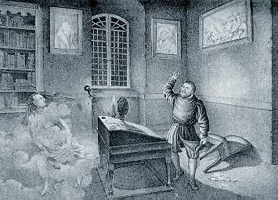
(9. MARTIN LUTHER)
He never made a deal with the Devil , but said the Devil visited him often, trying to tempt him.
Luther preached how to deal with the devil effectively and avoid making deals.
In his great hymn, “A Mighty Fortress is Our God,” Luther wrote about the dangers of the devil in the 3rd stanza.
(9. MARTIN LUTHER)
LEADER OF THE REFORMATION
(1483-1546)

Slide 23
Martin Luther (1483-1546)
A Mighty Fortress is Our God
A mighty fortress is our God,
a bulwark never failing;
our helper he amid the flood
of mortal ills prevailing.
For still our ancient foe
doth seek to work us woe;
his craft and power are great,
and armed with cruel hate,
on earth is not his equal.
Did we in our own strength confide,
our striving would be losing,
were not the right man on our side,
the man of God's own choosing.
Dost ask who that may be?
Christ Jesus, it is he;
Lord Sabaoth, his name,
from age to age the same,
and he must win the battle.
And though this world, with devils filled,
should threaten to undo us,
we will not fear, for God hath willed
his truth to triumph through us.
The Prince of Darkness grim,
we tremble not for him;
his rage we can endure,
for lo, his doom is sure;
one little word shall fell him.
That word above all earthly powers,
no thanks to them, abideth;
the Spirit and the gifts are ours,
thru him who with us sideth.
Let goods and kindred go,
this mortal life also;
the body they may kill;
God's truth abideth still;
his kingdom is forever.

Slide 24
IV. CONCLUSION: WHAT PEOPLE IN LIFE &LITERATURE ARE MOST AT RISK FOR PACTING WITH THE DEVIL?
CHURCHMEN, PRIESTS, BISHOPS, POPES, HERETICS
LEARNED MEN, SCHOLARS, SCIENTISTS, OVERREACHERS
MAGICIANS, SORCERERS, WITCHES
MUSICIANS, ESPECIALLY VIOLINISTS
CREATIVE PERSONALITIES –WRITERS, ARTISTS, COMPOSERS
DICTATORS, TYRANTS, POWER-HOLDERS
MASS MURDERERS, ARCH-CRIMINALS

Slide 25
COMING NEXT…
WHO IS THE DEVIL?

